Slide 1
Data Structures
15. Tree Data Structure
15-Tree
1

Slide 2
Trees
Hierarchical data structure
Examples:
TOC in a book has a shallow tree structure
A family tree
Others?

Slide 3
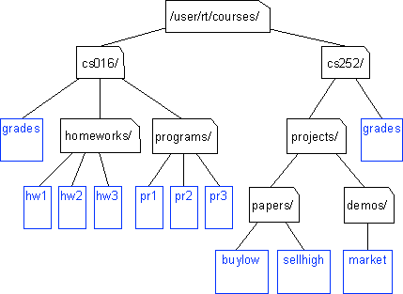
Unix / Windows file structure

Slide 4
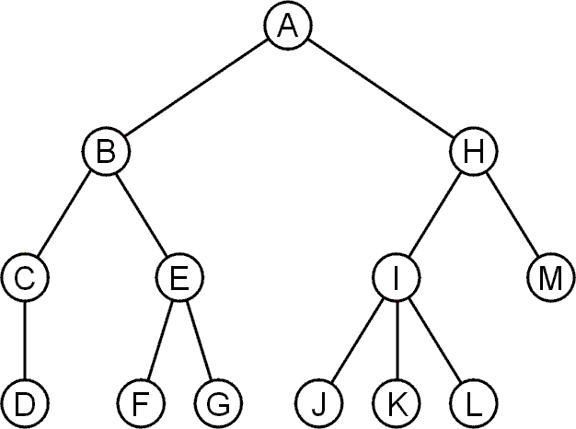
Trees
A rooted tree data structure stores information in nodes
Similar to lists:
There is a first node, or root
Each node has variable number of references to successors
Each node, other than the root, has exactly one node pointing to it

Slide 5
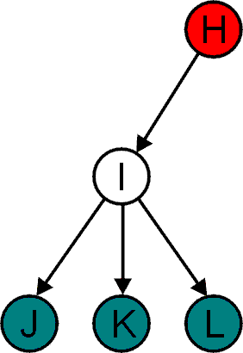
Terminology: Parent Child Relations
All nodes will have zero or more child nodes or children
I has three children: J, K and L
For all nodes other than the root node, there is one parent node
H is the parent I

Slide 6
Terminology: Degree
The degree of a node is defined as the number of its children
deg(I) = 3
Nodes with the same parent are siblings
J, K, and L are siblings

Slide 7
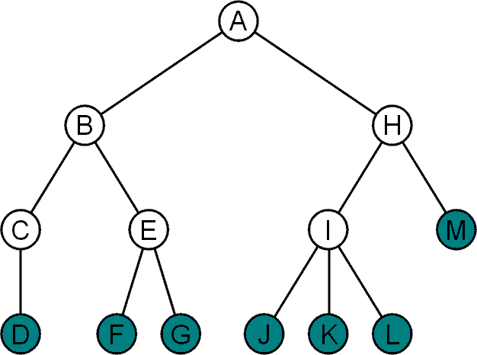
Terminology: Leaf And Internal Nodes
Nodes with degree zero are also called leaf nodes
All other nodes are said to be internal nodes, that is, they are internal to the tree

Slide 8
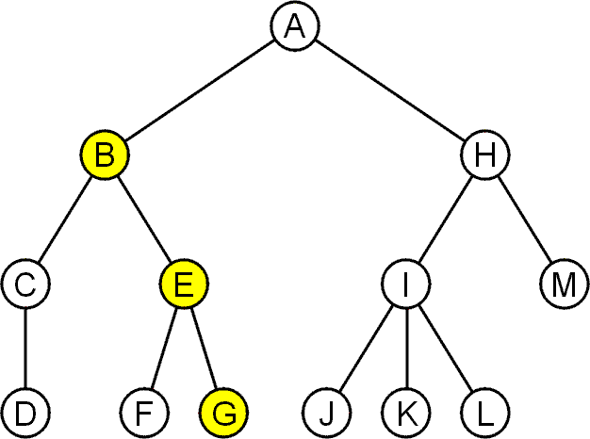
Terminology: Path
A path is a sequence of nodes (a₀, a₁, ..., a_{n})
Where a_{k+1} is a child of a_{k}
The length of this path is n
For example, the path (B, E, G) has length 2
10

Slide 9
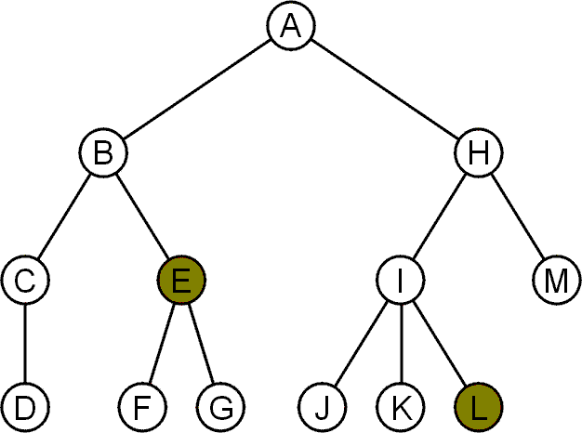
Terminology: Depth (or Level)
For each node in a tree, there exists a unique path from the root node to that node
The length of this path is the depth of the node, e.g.,
E has depth 2
L has depth 3
12

Slide 10
Terminology: Height
The height of a tree is defined as the maximum depth of any node within the tree
The height of a tree with one node is 0
– Just the root node
For convenience, we define the height of the empty tree to be –1

Slide 11
Terminology: Height Example
Height of this tree is 3
3

Slide 12
Terminology: Ancestors And Descendants
If a path exists from node a to node b
a is an ancestor of b
b is a descendent of a
Thus, a node is both an ancestor and a descendant of itself
We can add the adjective strict to exclude equality
a is a strict descendent of b if a is a descendant of b but a ≠ b
The root node is an ancestor of all nodes

Slide 13
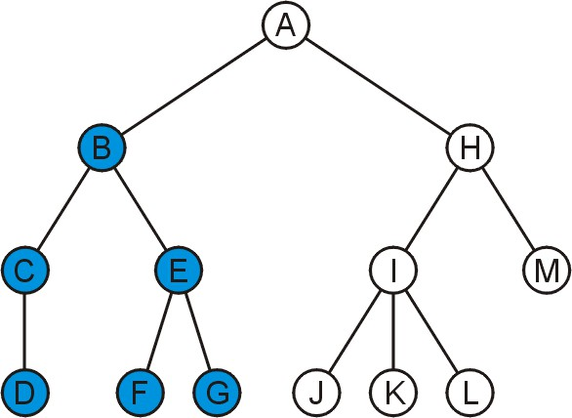
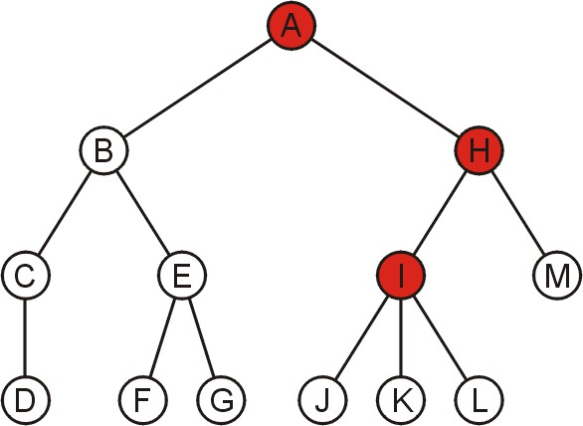
Terminology: Ancestors And Descendants Example
The descendants of node B are C, D, E, F, and G
The ancestors of node I are H and A

Slide 14
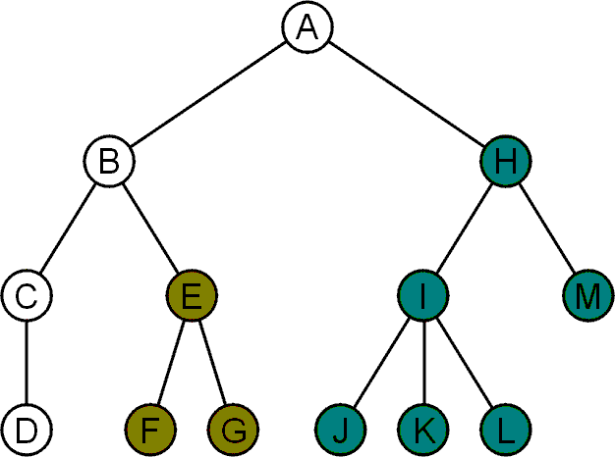
Terminology: Sub-Tree
Another approach to a tree is to define the tree recursively
A degree-0 node is a tree
A node with degree n is a tree if it has n children
All of its children are disjoint trees (i.e., with no intersecting nodes)
Given any node a within a tree with root r, the collection of a and all of its descendants is said to
be a subtree of the tree with
root a

Slide 15
Tree Properties
A
Property Number of nodes Height
Root Node Leaves Ancestors of H
Descendants of B Siblings of E
Left subtree
Value
B
C
D
E
F
G
H
I

Slide 16
Binary Tree

Slide 17
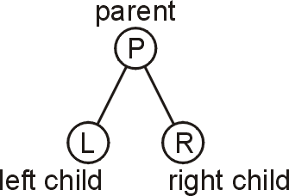
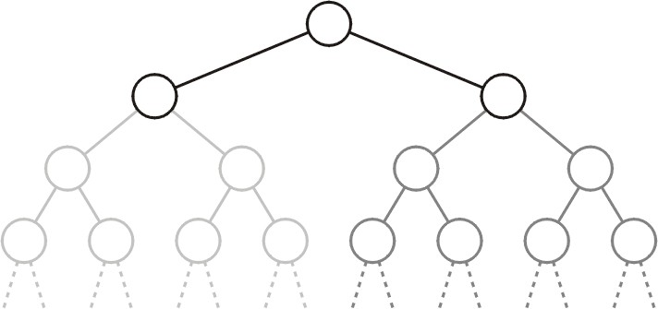
Binary Tree
In a binary tree each node has at most two children
– Allows to label the children as left and right
- 0, 1, 2
Likewise, the two sub-trees are referred as
Left sub-tree
Right sub-tree

Slide 18
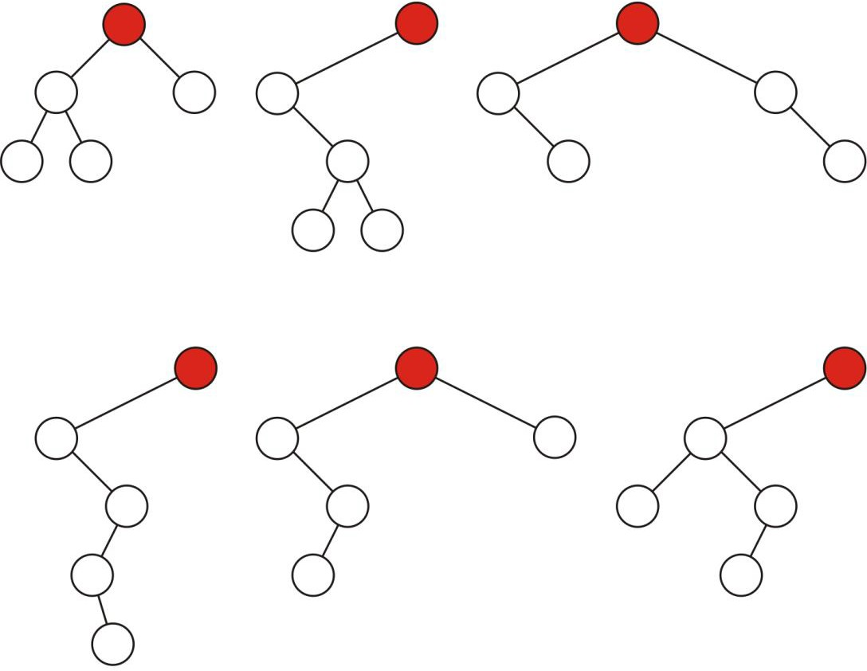
Binary Tree: Example
Some variations on binary trees with five nodes

Slide 19
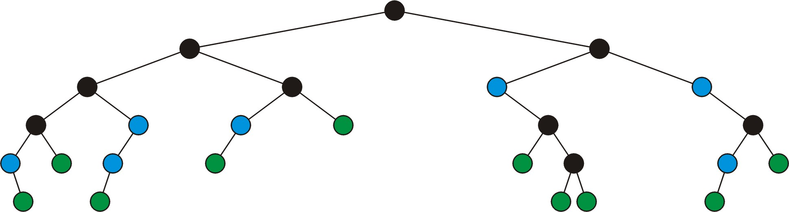



Binary Tree: Full Node
A full node is a node where both the left and right sub-trees are non-empty trees
full nodes
neither
leaf nodes

Slide 20
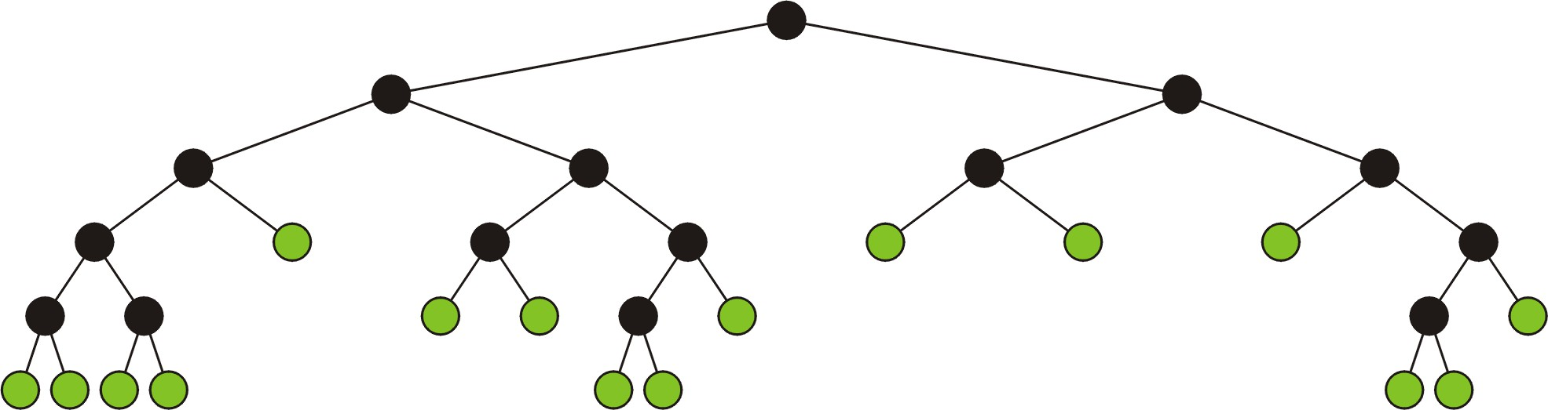
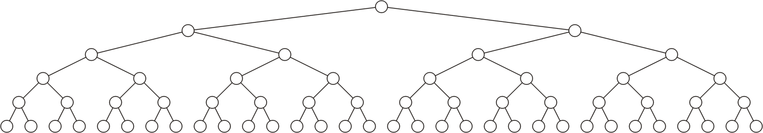
Full Binary Tree
A full binary tree is where each node is:
A full node, or
A leaf node
Full binary tree is also called proper binary tree, strictly binary tree or 2-tree

Slide 21
Complete (Or Perfect) Binary Tree
A complete binary tree of height h is a binary tree where
All leaf nodes have the same depth h
All other nodes are full

Slide 22
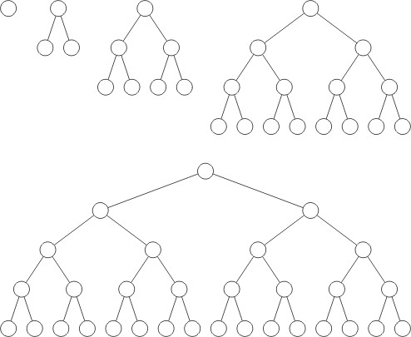
Complete Binary Tree: Example
Complete binary trees of height h = 0, 1, 2, 3 and 4

Slide 23
Complete Binary Tree: Recursive Definition
A binary tree of height h = 0 is perfect
A binary tree with height h > 0 is perfect
– If both sub-trees are prefect binary trees of height h – 1

Slide 24
Binary Tree: Definitions
A perfect binary tree is a binary tree in which:
All internal nodes have exactly two children
All leaf nodes are at the same level
Recursive Definition:
Base case:
A binary tree of height h = 0 (i.e., just a single node) is perfect
Recursive case:
A binary tree of height h > 0 is perfect if:
Both its left and right subtrees are perfect binary trees, each of height h - 1.

Slide 25
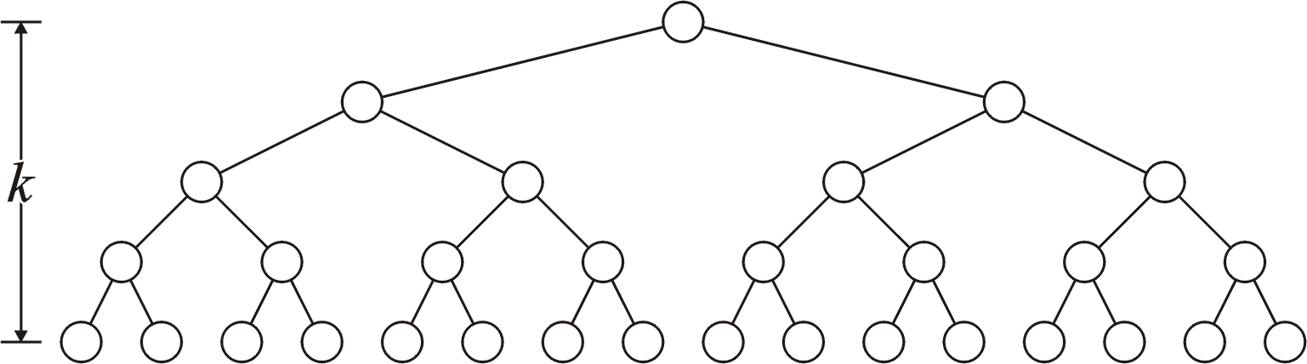
Binary Tree: Properties (1)
A complete binary tree with height h has 2^{h} leaf nodes
h

Slide 26
Complete Binary Tree: Example
Complete binary trees of height h = 0, 1, 2, 3 and 4

Slide 27
Binary Tree: Properties (2)
A complete binary tree with height h has 2^{h} leaf nodes
A complete binary tree of height h has 2^{h + 1} – 1 nodes
h
n = 2⁰ + 2¹ + 2² + ... + 2^{h} = ∑ 2^{j}
j= 0
₌ ₂h + 1
− 1
h

Slide 28
Binary Tree: Properties (3)
A complete binary tree with height h has 2^{h} leaf nodes
A complete binary tree of height h has 2^{h + 1} – 1 nodes
Number of leaf nodes: L = 2^{h}
Number of internal nodes: 2^{h} – 1
Total number of nodes: 2L-1 = 2^{h + 1} – 1
h

Slide 29
Binary Tree: Properties (4)
A complete binary tree with height h has 2^{h} leaf nodes
A complete binary tree of height h has 2^{h + 1} – 1 nodes
Number of leaf nodes: L = 2^{h}
Number of internal nodes: 2^{h} – 1
Total number of nodes: 2L-1 = 2^{h + 1} – 1
A complete binary tree with n nodes has height log₂(n + 1) – 1
_{n = 2}h+ 1
− 1
₂h+ 1
= n + 1
h + 1 = log₂(n + 1)
⇒ h = log₂(n + 1) - 1

Slide 30
Binary Tree: Properties (4)
A complete binary tree with height h has 2^{h} leaf nodes
A complete binary tree of height h has 2^{h + 1} – 1 nodes
Number of leaf nodes: L = 2^{h}
Number of internal nodes: 2^{h} – 1
Total number of nodes: 2L-1 = 2^{h + 1} – 1
A complete binary tree with n nodes has height log₂(n + 1) – 1
Number n of nodes in a binary tree of height h is at least h+1
and at most 2^{h + 1} – 1

Slide 31
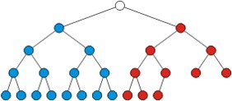
Almost (or Nearly) Complete Binary Tree
Almost complete binary tree of height h is a binary tree in which
There are 2^{d} nodes at depth d for d = 1,2,...,h−1
Each leaf in the tree is either at level h or at level h– 1
The nodes at depth h are as far left as possible
Complete binary tree of height h-1
Missing node towards the right
15-Tree

Slide 32
Almost (or Nearly) Complete Binary Tree
Almost complete binary tree of height h is a binary tree in which
There are 2^{d} nodes at depth d for d = 1,2,...,h−1
Each leaf in the tree is either at level h or at level h– 1
The nodes at depth h are as far left as possible (Formal ?)
Complete binary tree of height h-1
Missing node towards the right
15-Tree

Slide 33
Almost (or Nearly) Complete Binary Tree
Condition 2: The nodes at depth h are as far left as possible
If a node p at depth h−1 has a left child
Every node at depth h−1 to the left of p has 2 children
If a node at depth h−1 has a right child
It also has a left child
Almost Complete binary tree
Not Almost Complete binary tree (condition 2 violated)

Slide 34
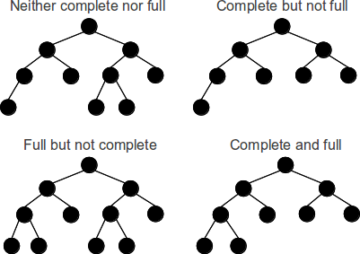
Full vs. Almost Complete Binary Tree

Slide 35
Almost Complete Binary Tree: Properties
Total number of nodes n are between
Complete binary tree of height h-1, i.e., 2^{h} nodes
Complete binary tree of height h, i.e., 2^{h+1} -1 nodes
Height h is the largest integer less than or equal to log₂(n)

Slide 36
(Completely) Balanced Binary Tree
Balanced binary tree
For each node, the difference in height of the right and left sub-trees
is no more than one
Completely balance binary tree
Left and right sub-trees of every node have the same height

Slide 37
(Completely) Balanced Binary Tree: Example
a
b
d e f g
h i j
A balanced binary tree
a
b
c e
f
g h
i j
An unbalanced binary tree
c
d

Slide 38

Any Question So Far?

